Slide 1



CcpNmr Analysis Version 3
Chemical Shift Perturbation
Tutorial
Written by: Luca Mureddu
CCPN application developer, PhD Student
MCB, University of Leicester, Lancaster Road, Leicester, LE1 9HN, UK
t: +44 (0) 116 229 7074
e: lgm8@le.ac.uk

Slide 2
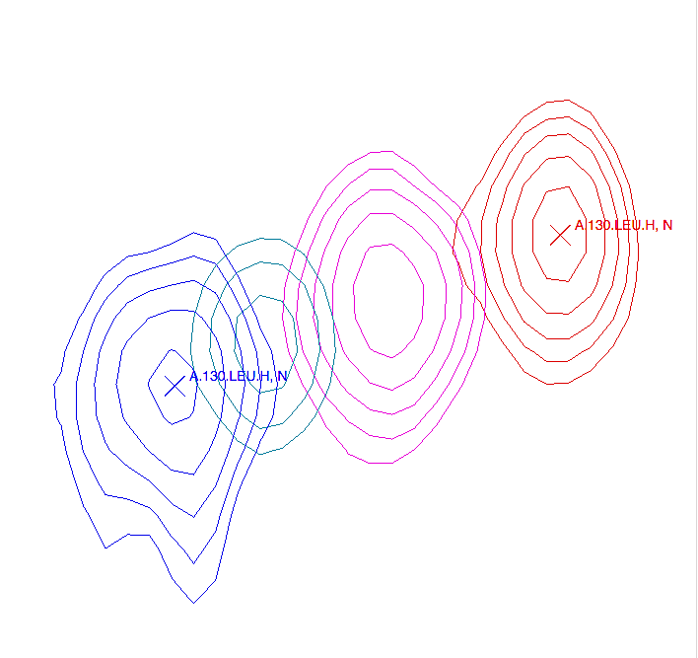

Introduction
NMR is a very powerful technique to map the interaction between two biological partners. The peaks on the spectrum represent the correlation between the amide protons and the nitrogen connected to it (H – N) (15N – HSQC). Each peak represents an NH of each residue (except for the first residue and the prolines), the side chain of a few amino acids (Asn, Gln, His and Trp) can also give a peak.
The chemical shift (nitrogen and proton) is sensitive to the chemical environment of the two nuclei. Any chemical environment modifications of amino acids by the addition of another molecule will affect the position of the peaks in the spectrum.
The analysis and the mapping of these shifts on the protein structure will give information on the binding interface.
In this NMR practical, you will have to analyse the 15N – HSQC spectra of a 15N labelled TSTAR protein in complex with RNA and to map this interaction onto the structure of the protein.
Start CcpNmr Analysis V3
Apple users by double clicking the icon CcpNmrAnalysis
Linux users by using the terminal command: bin/assign

Slide 3
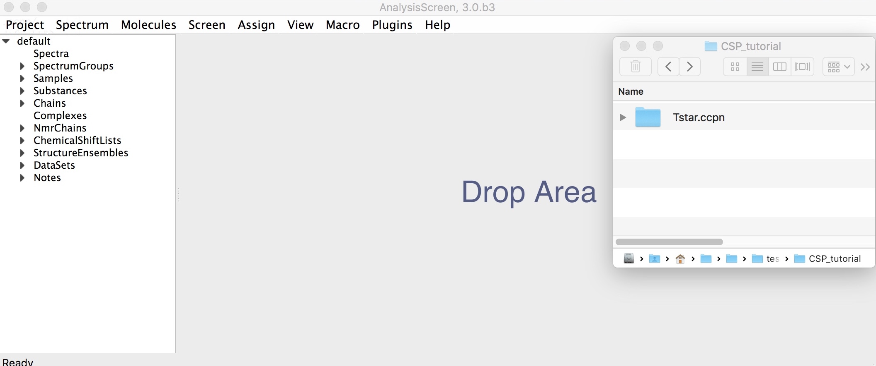
1
Open Project
1A
Drag & drop “Tstar.ccpn” into the sidebar or Drop Area. CcpNmr projects have an extension of type “filename.ccpn”. Find the project file Tstar.ccpn in the top directory or in AnalysisV3/data.
Select the file “Tstar.ccpn”, drag and drop into the program. The Tstar project will be loaded in a new window.
You will see five spectra, displayed as:
Tstar-free (red)
Tstar-0:50eq (orange)
Tstar-1:00eq (green)
Tstar-1:50eq (blue)
Tstar-2:00eq (black)

Slide 4
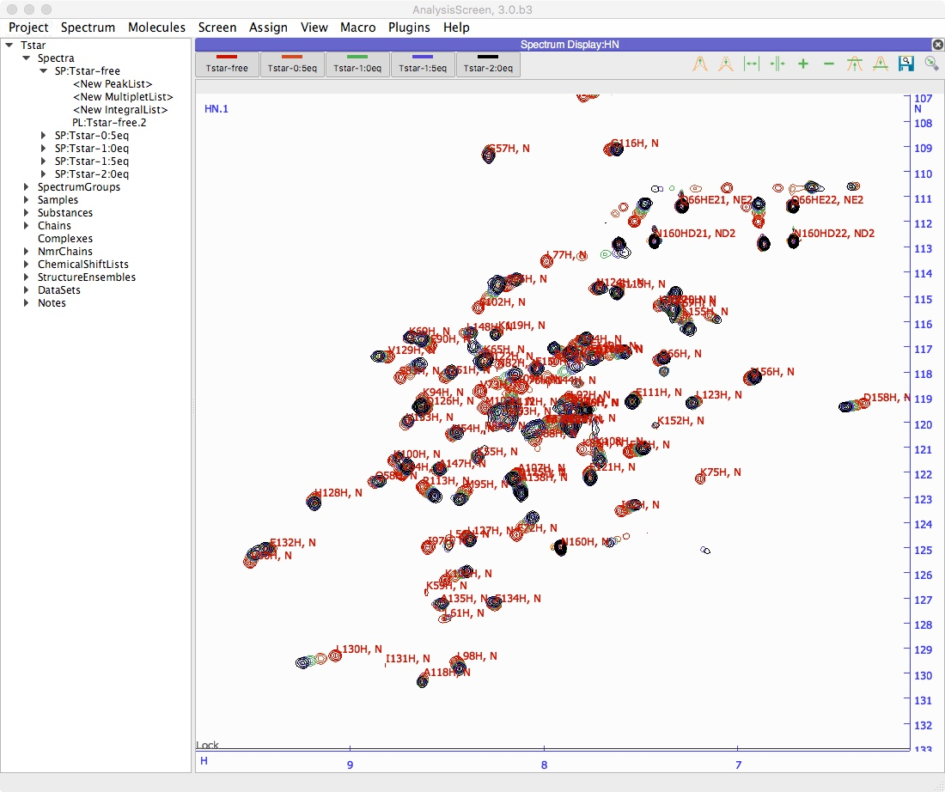
1
Open Project
Getting started, basic operations
Sidebar
All spectra and peak lists are located in sidebar. Double click on an item will open the properties popup.
Display
A display can contain multiple overlaid spectra. To show/hide a single spectrum, click on its toolbar button. See next page.
If you close a display. You can open a new one from main menu -> view -> New Blank Display. Drag and drop into it the spectra from sidebar.
Mouse
Pan -> Left Click and drag in display
Zoom in/out -> Scroll wheel in display
Context menu -> Right click
Select a peak -> Left click on a peak symbol “X”
Move a peak -> select first then hold Middle and drag
Shortcuts
The program uses several shortcuts, example “CL” for copying a peak list. You will need to press the first letter on your keyboard e.g. “C”, followed by the second letter, e.g. “L” .
Fore more commands and operations: main menu -> help -> Tutorial (Beginners) or Show Shortcuts

Slide 5
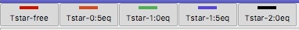
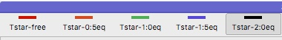
1
Open Project
Toolbar buttons
1B
Toggle off all spectra apart from Tstar-2:00eq on the toolbar.
Click on the toolbar button of the first four spectra (a, b, c, d). The buttons will change colour from dark orange* (spectrum visible on the display, “toggle On”) to light yellow* (spectrum hidden on the display, “toggle Off”)
1 Click to toggle on the spectra

Slide 6
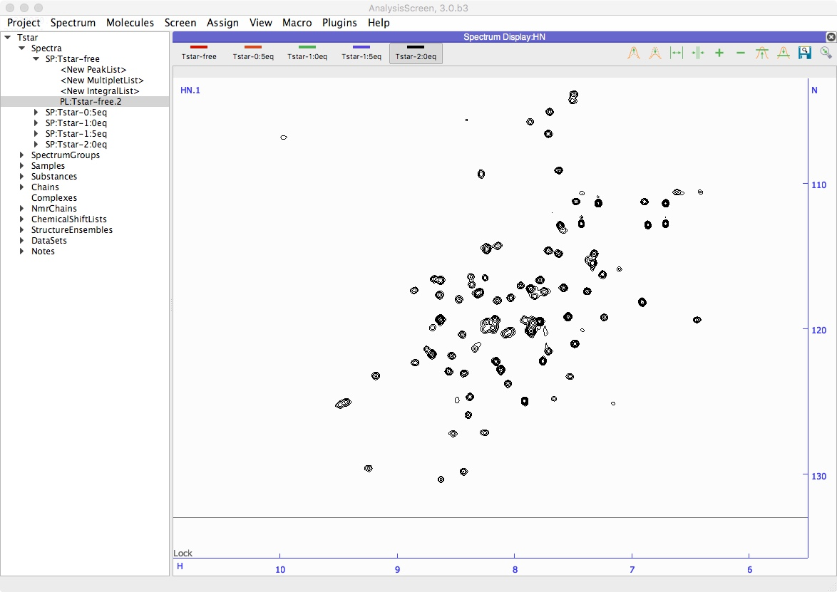
2
Copy Peak List
Drop “PL:Tstar-free.2” here
Only the Free-Form Tstar has a peak list. You will need to copy this peak list to a spectrum recorded with Tstar bound to the RNA.
2A
Drag & drop the peak list tree item “PL:Tstar-free” into the spectrum display.
On side bar, expand the tree:
tStar
Spectra
SP:Tstar-free PL:Tstar-free.2
Click to select PL:a-Tstar-free.2, drag and drop the item into the spectrum display.

Slide 7
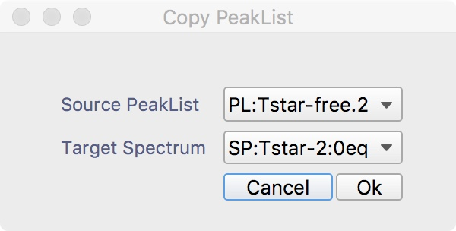
2
Copy Peak List
2B
Select target Spectrum: e-200. A new popup will open, the first entry is the peak list source you want to copy; the second entry is the target spectrum, where the peak list will be copied.
Select:
Source PeakList: PL: Tstar-free
Target Spectrum: SP:Tstar-2:00eq
Press Ok

Slide 8
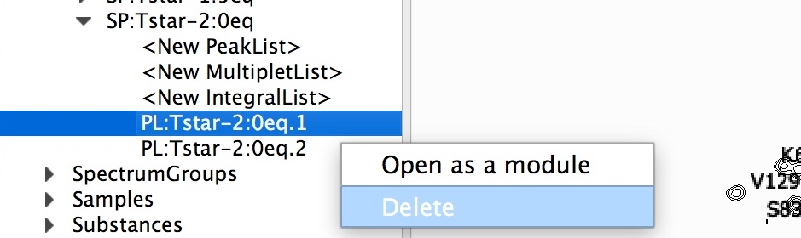
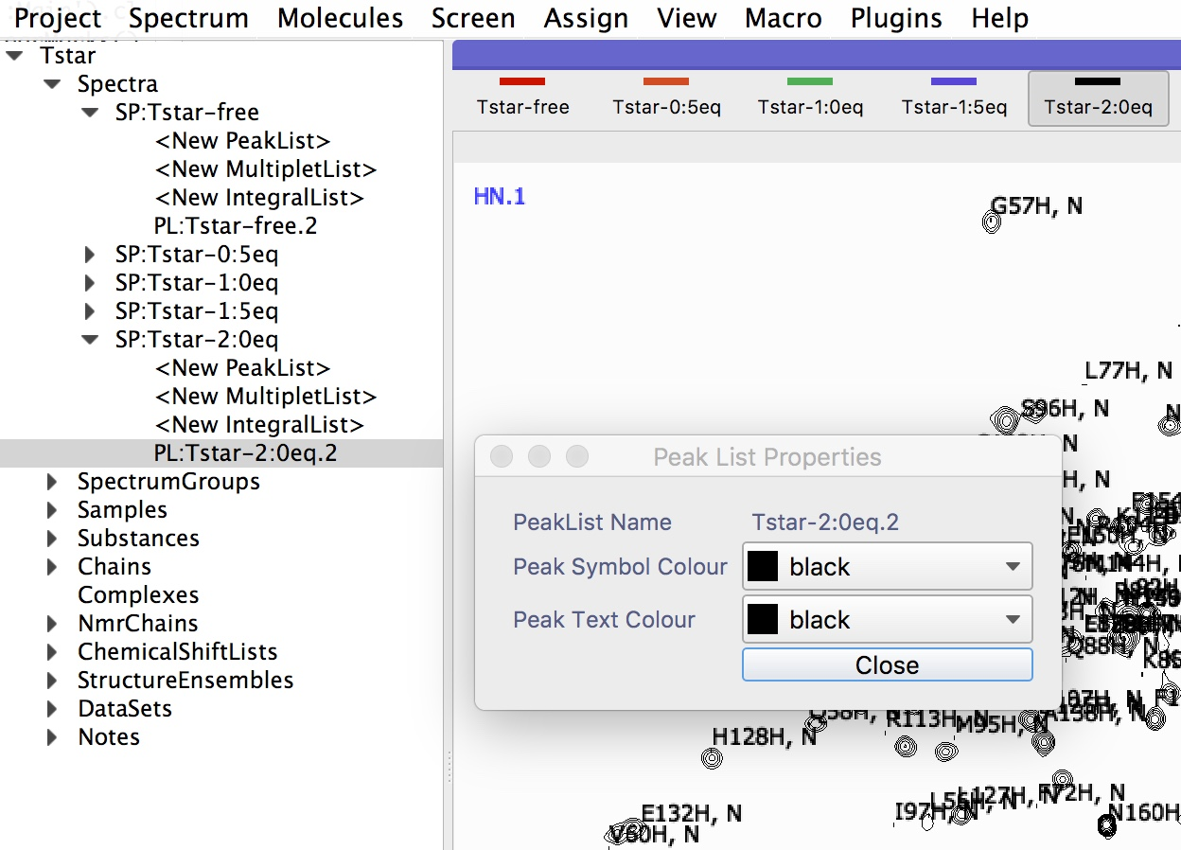
2
Copy Peak List (Optional)
2C
PL:Tstar-2:00eq.1
Right click to delete
2D
PL:Tstar-2:00eq.2
Double click To change colours
2C
Delete “PL:Tstar-2:00eq.1” from side bar. The default peak list for the spectrum Tstar-200 is empty. For simplicity delete it from side bar. Right click on the item Tstar-2:00eq.1 then click delete.
2D
Double Click on sidebar item “PL:Tstar-2:00eq.2 ” to change colours.
Expand the spectrum item tree SP:e-tStar-200 on side bar, like previously for the SP:free-tStar
Double click on “PL:Tstar-2:00eq.2
A new popup will open.
Select the desired colours for text labels and symbols. Close the popup.
Tip: use the same colour as the spectrum contours.

Slide 9
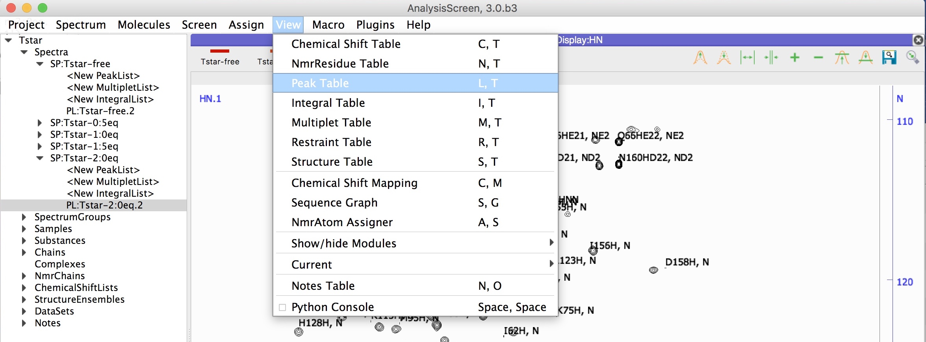
3
Move Peaks
3B
Open peak table, shortcut “LT”. Open a peak table with the shortcut ”LT” or from the main menu -> view -> Peak Table.
PL:Tstar-200eq.2
3C
Select PL:e-Tstar-200.2.
On the top left corner of the peak table there is a pulldown menu, select the newly created peak list: PL:Tstar-2:00eq.2.

Slide 10
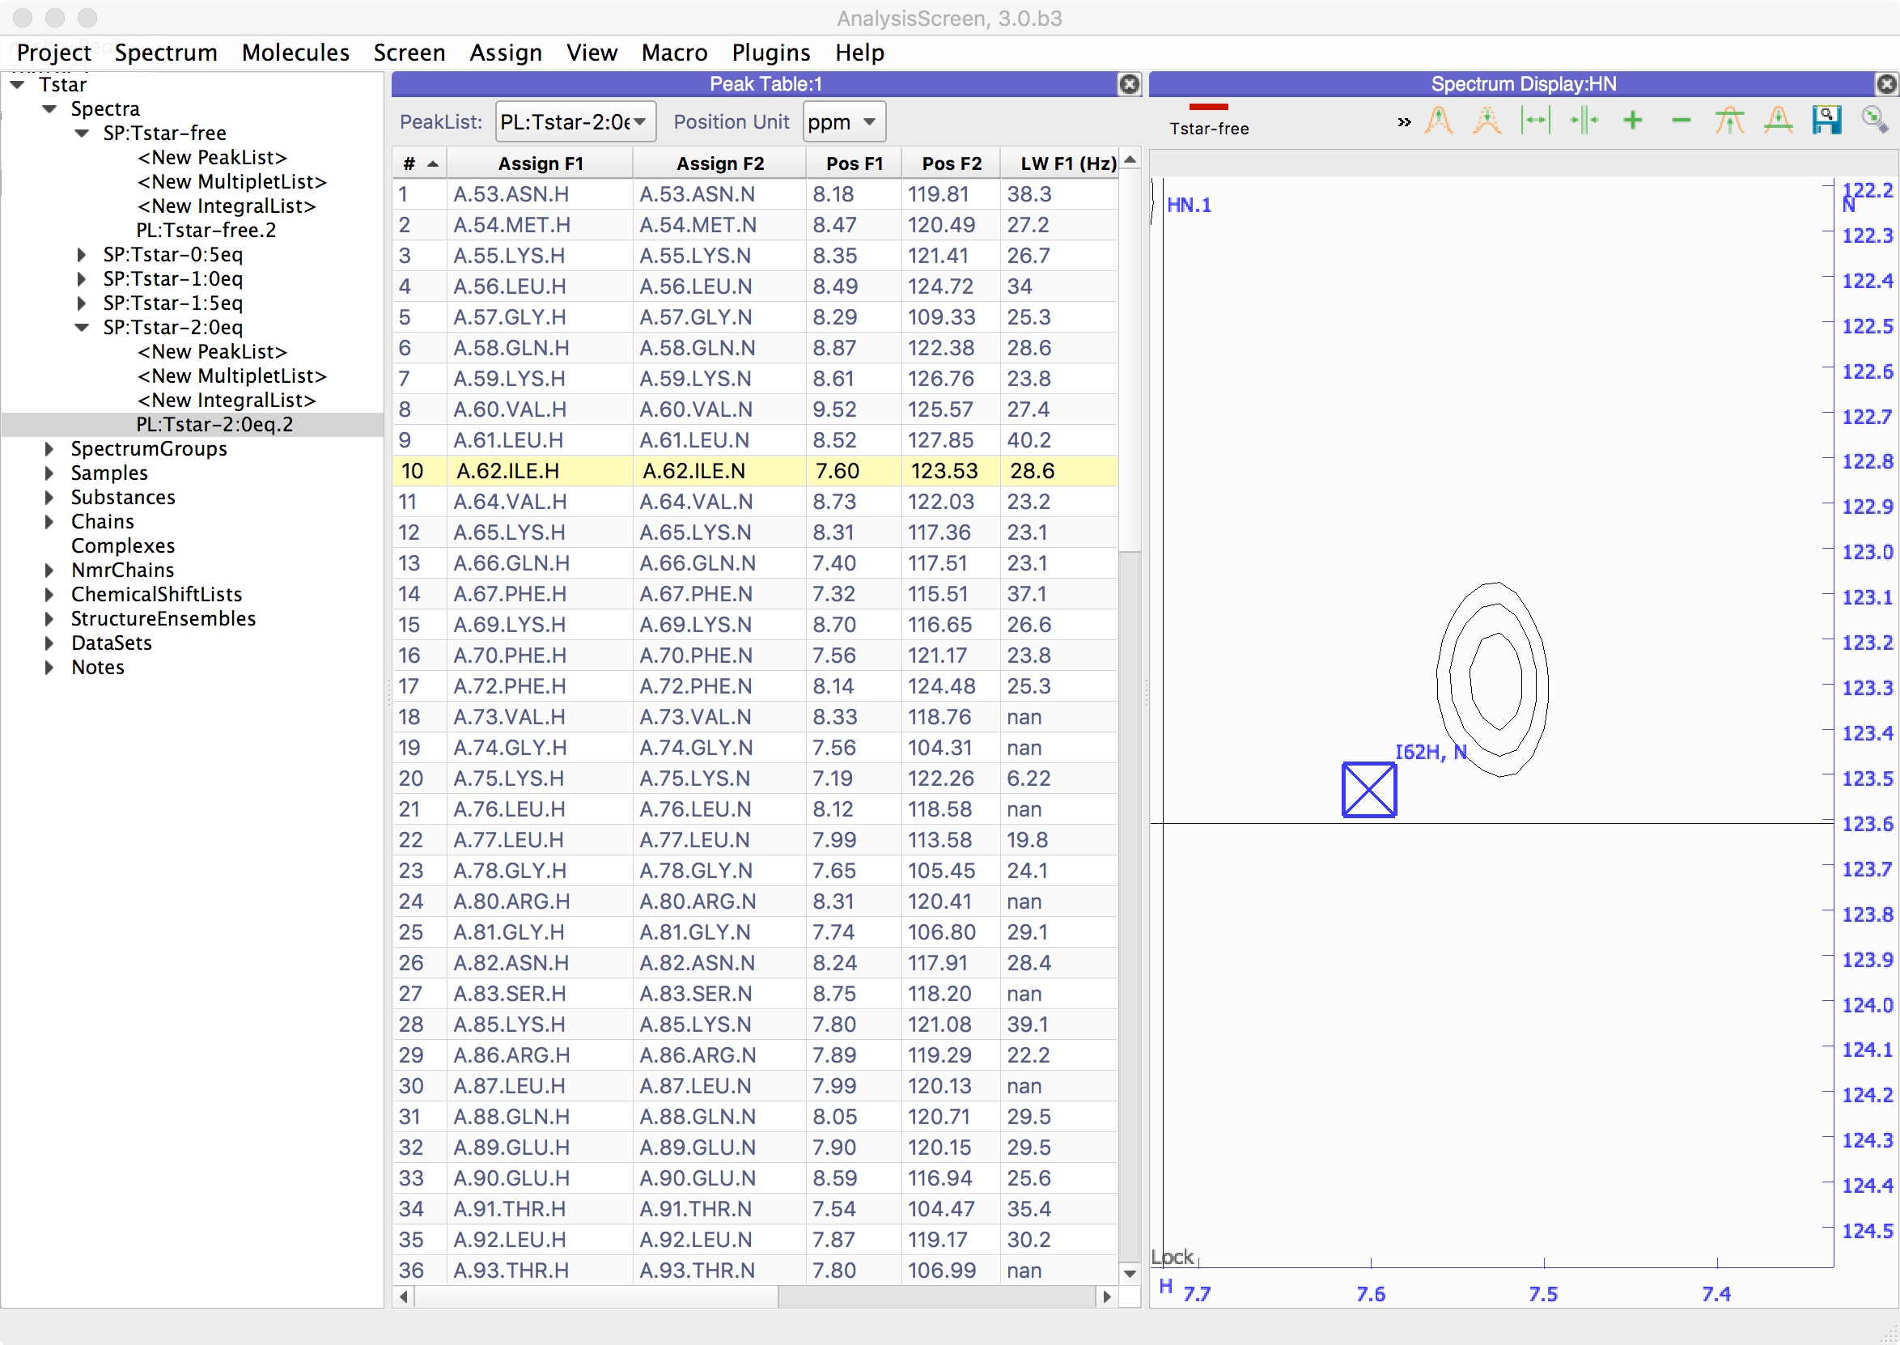
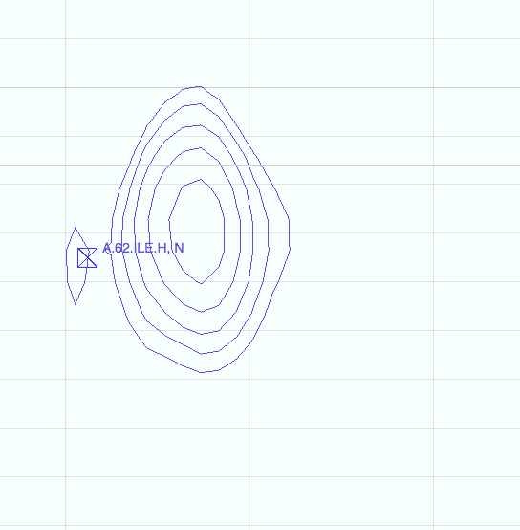
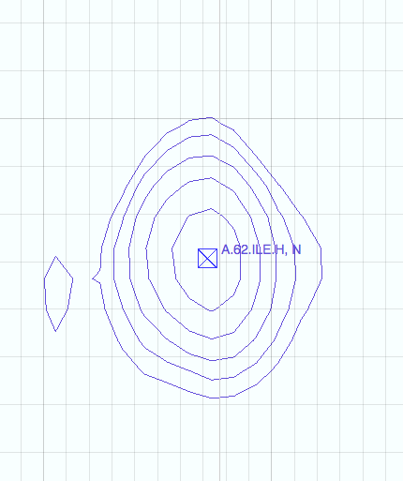
3
3
Move Peaks
Double click #10
This peak list was copied from Tstar without ligand, therefore, some peak will have changed position upon titration with the ligand. You will have to find the shifted peaks and correct their position.
3D
Move peaks manually.
Locate a single peak and zoom in using the middle mouse wheel, until it’s in the middle of the display. Hold down the left mouse button and drag to pan the spectrum.
On the peak table, double click on a row, e.g. # 10 | A.62.ILE. The spectrum display will navigate to the selected peak coordinates.
Move the mouse cursor on top the selected peak [X]: hold down the middle mouse wheel button and drag across the selected peak. The peak will start to move, when you are in the correct position, release the mouse button.
Use the shortcut “SE” to centre the peak to its extremum.
hold middle mouse and drag
Release

Slide 11
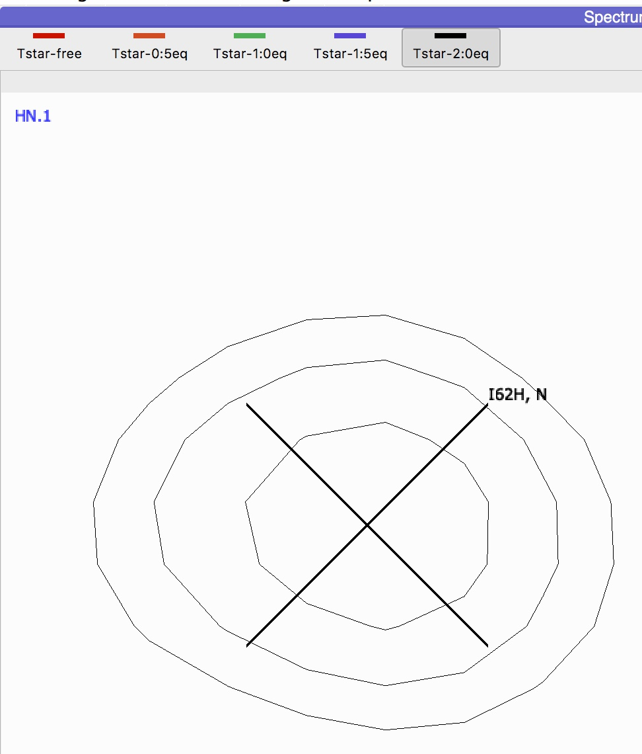
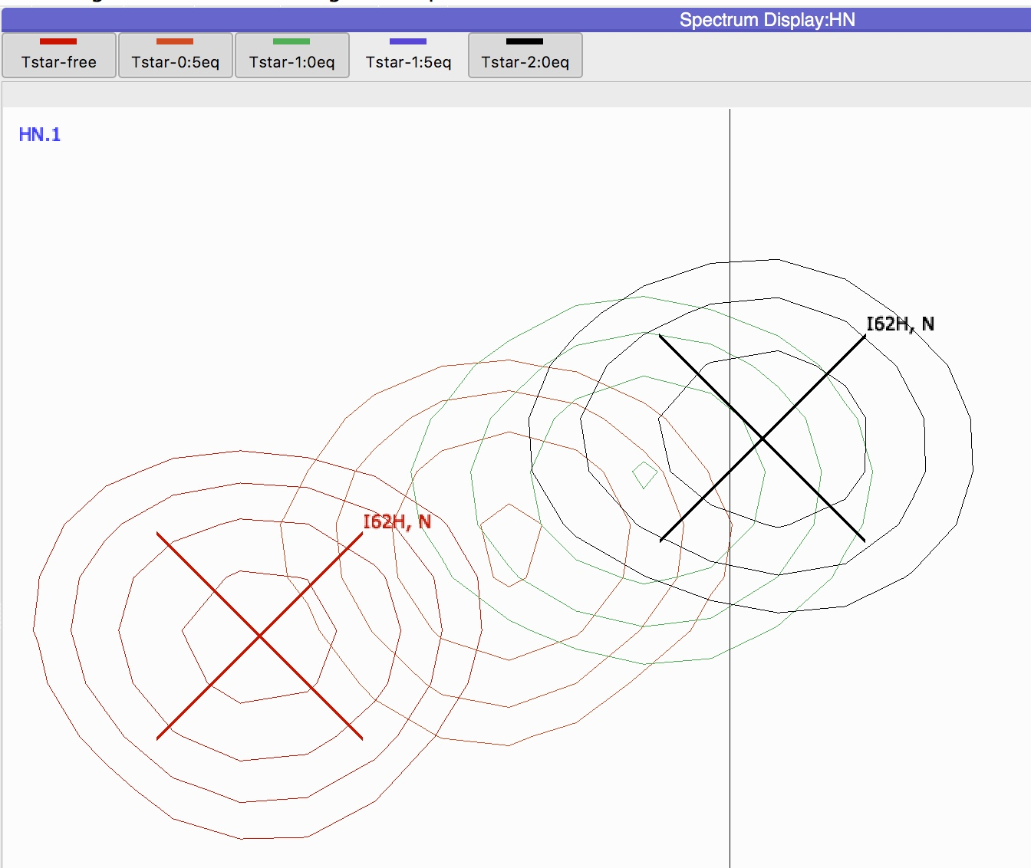
3
3
Move Peaks
To change the order how spectra are displayed: Middle mouse on the toolbar button and drag and drop the button to a new positon in the toolbar
3E
Map the trajectory.
To map the trajectory of the peak shifts it is important to check the other spectra too.
toggle on and off manually the spectra on the toolbar to see any differences in the peak positions across the different spectra.
Useful shortcuts:
“Tab-Tab” (press twice ⇥⇥) Displays the next spectrum and hides all others
“Tab-A” : Displays all spectra
“Tab-x” : Reverts displayed spectra
To have a full overview of the ChemicalShiftMapping module, you will need to repeat points 3D and 3E for as many peaks as possible. The project “TstarCompleted.ccpn” includes fitted peaks for all spectra, you might continue the tutorial using that project instead.

Slide 12
3
4
Map Peaks
The Chemical Shift Mapping module includes a bar chart plot, a residue table and a settings panel.
As previously stated, each peak represents a single residue in the protein (apart from the sidechain peaks). From now on, we will refer as NmrResidue for a residue assigned to its spectrum peak. In green are plotted the NmrResidues that have moved above a threshold of 0.1 ppm; in red the others.
4A
Open the Chemical Shift Mapping module, shortcut “CM”.
Once you have moved all peaks correctly, inspect the chemical shift perturbations using the Chemical Shift Mapping module.
Go to the main menu -> View ->Chemical Shift Mapping module or use the shortcut “CM”.

Slide 13
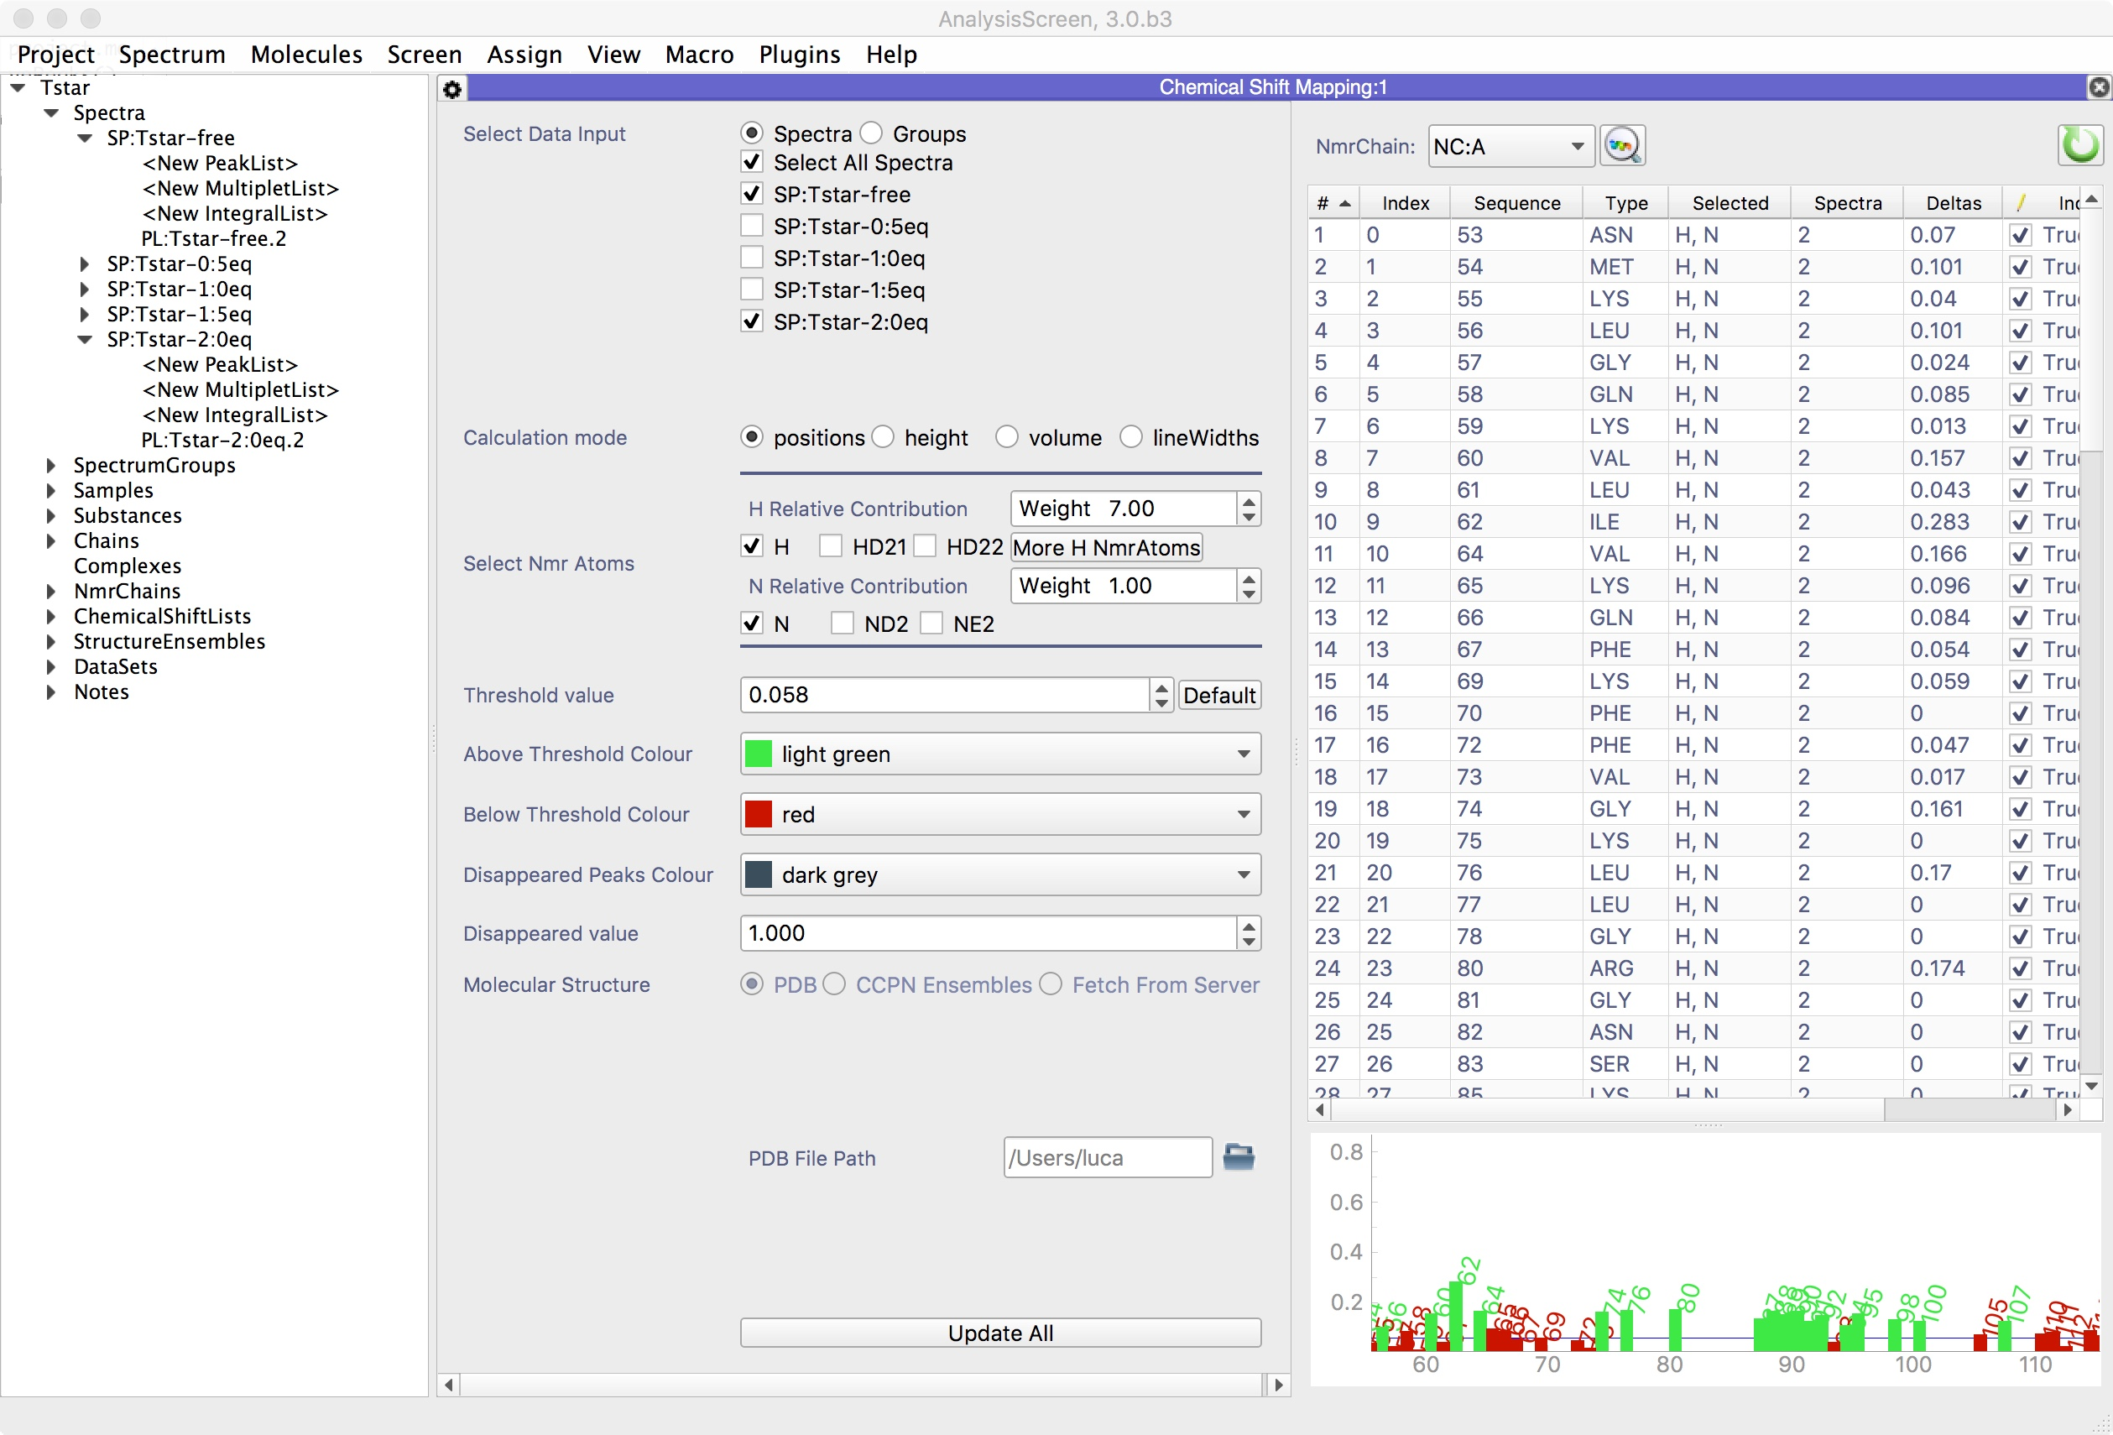
3
4
Map Peaks
4B
Changing the default values.
Click the “gear icon” in the top left corner of the module .
Set:
Relative Contribution: H = 6.5, N = 1
Threshold line: 0.200 ppm
Leave Select Atoms as the default
You might want to change the plot colours
PDB file Path: click the folder icon and select TSTAR-KH.pdb in the pymol directory. Full path tStar.ccpn/scripts/pymol/TSTAR-KH.pdb
Click the Update All button.

Slide 14
3
4
Map Peaks (Optional)
4C
Find the disappeared Peak.
In this protein a peak has disappeared after the titration with the ligand.
If present in the plot, double click on the residue bar 97 to navigate to the residue coordinates on the spectrum display, otherwise double click on the peak table #40 | A.97ILE.H | A.97ILE.N.
Right click and Delete the peak from the spectrum Tstar-2:00eq You can add a comment on the Comment column Chemical Shift Mapping table cell by double clicking inside the cell.
The plot will automatically refresh and mark the residue as ”missing”
4D
Export plot.
Right click in the plot in an empty space
Click Show Label Above Threshold
Click Export
On the Export popup Select Image File, then click export
Save the file

Slide 15
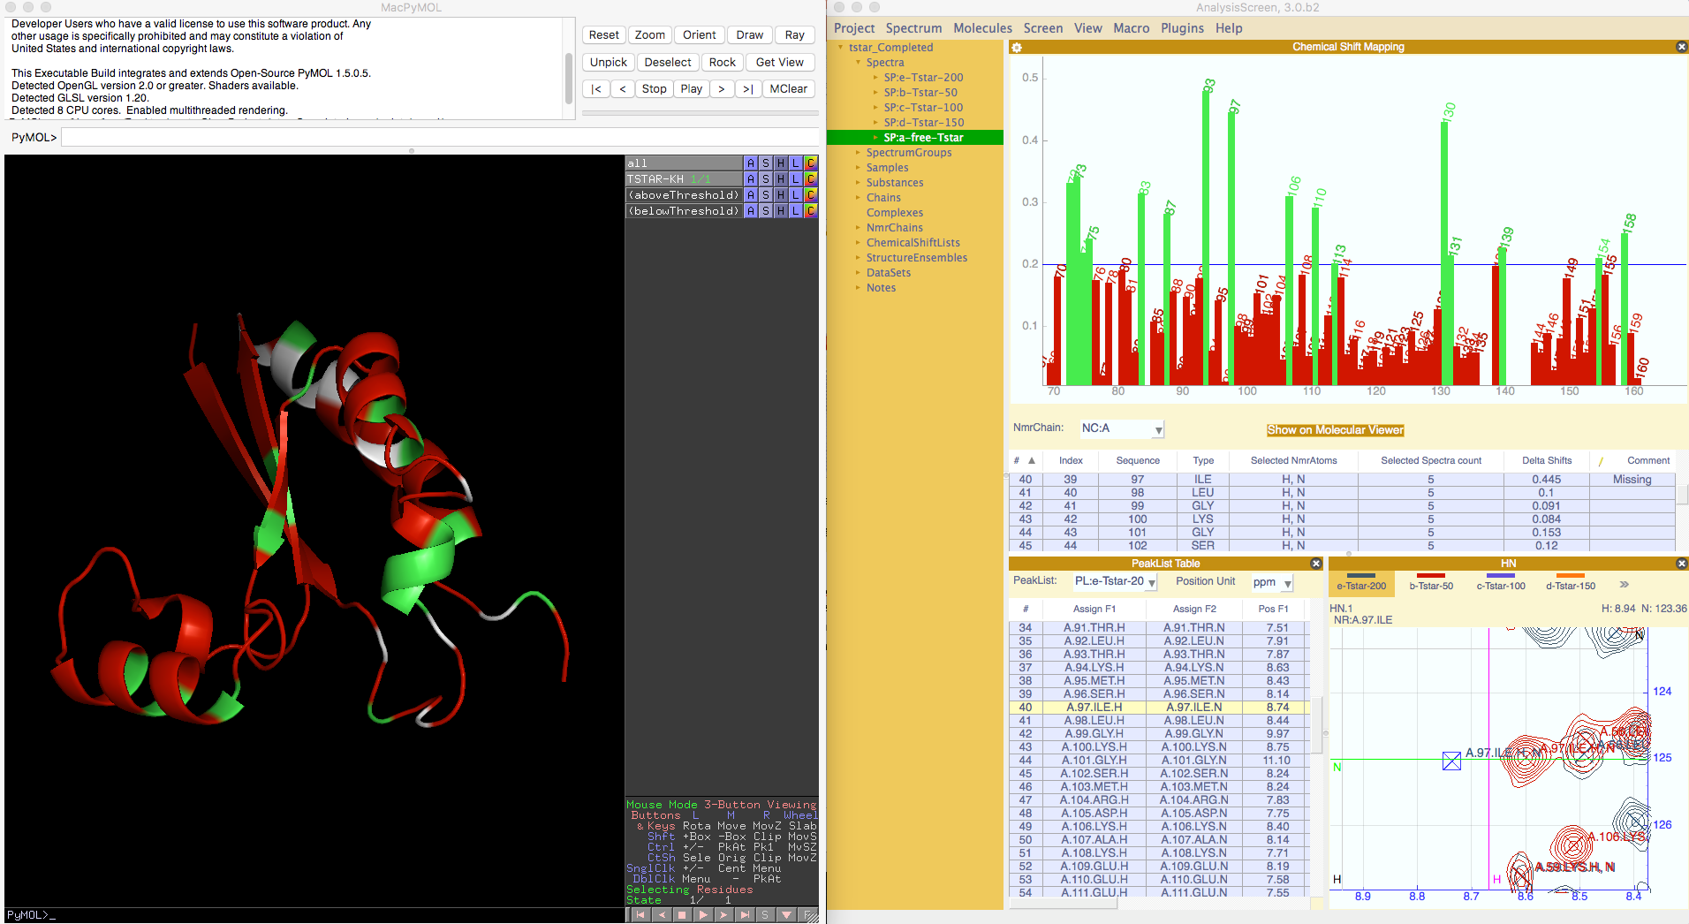
3
5
PyMOL
PyMOL is a Python-enhanced molecular graphics tool. It excels at 3D visualisation of proteins, small molecules, density, surfaces. The visualisation through PyMOL of the perturbed residues on the surface's protein can be started using CcpNmr.
Download and install from https://pymolwiki.org/index.php/MAC_Install
5A
Link PyMol to CcpNmr Analysis
Main menu → Project → Preferences…
click on External Programs tab
on PyMol, click on the folder icon,
search on you disk the executable PyMol file, on Mac will be on:
﻿/Applications/MacPyMOL.app/Contents/MacOS/MacPyMOL
click on Test, Pymol will start if has been linked successfully
click Ok

Slide 16
3
5
PyMOL
5B
Click “Show on Molecular Viewer”.
By clicking the button
on the Chemical Shift mapping inside CcpnNmr Analysis, PyMol will be launched with the Tstar structure already loaded in. In Pymol two new selections will be created:
(aboveThreshold) , same colour as the bars in CcpNmr
(belowThreshold) , same colour as the bars in CcpNmr
(missing) , same colour as the bars in CcpNmr
You will be able now to analyse graphically the residues that are involved in the interaction with the ligand.
5C
(Optional) Export image with transparent background
Copy and paste these commands on the Pymol terminal:
set ray_opaque_background, 0
png ~/Desktop/tStar.png, width=1000, dpi=300, ray=1
press enter
Find the image on your desktop
Paste Here

Slide 17
3
6
Binding Curves
TstarCompleted.ccpn
6A
Drag & drop “TstarCompleted.ccpn” (uncompressed) into the sidebar. This project contains peak lists in all the spectra with already fitted peaks.
If not already opened, load the TstarCompleted and press “CM” to display the Chemical shift mapping module.
Display all five spectra in a single spectrum display and zoom to focus on a single peak.

Slide 18
3
6
Binding Curves
The binding plot is created based on 𝛥𝛿 for each spectrum recorded at different ligand concentrations. This functionality is also useful to spot fitting errors as described below.
6B
Select NmrResidues above threshold
Right click on the bar graph canvas and click Select above threshold.
All the binding curves for the selected NmrResidues will be plotted.
You might see some of the curves don’t follow a “one site binding” curve perfectly. It could be some of the peaks are not correctly fitted. E.g. the nmrResidue 102.SER
6C
Double click any of the point for the misplaced curve. (Colours may vary)
This will navigate to NmrResidue on the spectrumDisplay; using the ”Tab-Tab” shortcut follow the peak.

Slide 19
3
6
Binding Curves
6C
Move the peak for the spectrum Tstar-2.0eq.
This peak has an ambiguous position, once you place it, click the ”update” button
This will update the table and plots.
Click on the Fitting tab to inspect the estimated Kd for the select NmrResidue.
To exclude an NmrResidue from the multisection:
Hold cmd (ctrl) and click the item on the table.

Slide 20
1
Issues
3
Issues
Empty bar chart:
Check the selected NmrChain contains valid NmrResidues and nmrAtoms are assigned to peaks in at least two different spectra PeakLists:
SequenceCode for the NmrAtom is a numerical digit, e.g. sequenceCode=1
Check the peaks in the selected spectra (settings) are fitted correctly and have differences (position, height etc.) across the different spectra.
Check the selected NmrAtoms (settings) for ambiguous combinations. E.g. selecting H, H1, H2, Nh3 simultaneously might not give any results
Empty Binding curves:
Check at least three or more spectra (containing fitted peaks) are selected on the settings panel
Check Ddelta is not None or 0. See 1A2
Peaks not “snapping” to extrema (“SE” shortcut):
Shortcut out-of-sync. Try any pressing another key, then re-do “SE”
Peak is too far from the extremum. Move closer with the mouse or keyboard commands
PyMol not opening:
Check PyMol has been correctly linked to Analysis as 5A.
Alternatevely, You can run the PyMol script directly from PyMol. The CcpNmr scripts are located inside the project folder. For PyMol will be on: name.ccpn > script > pymol > chemicalShiftMapping_Pymol_Template.py Simply, run this file from the PyMol File menu.

Slide 21
CcpNmr Analysis Version 3
Contact Us
Website:
www.ccpn.ac.uk
Suggestions and comments:
ccpnmr3@google.com
Issues and bug report:
https://bitbucket.org/ccpnmr/issue-tracker/
Cite Us
Simple High-Resolution NMR Spectroscopy as A Tool in Molecular Biology. Mureddu and Vuister, 2018. (submitted on FEBS)
Skinner, S. P. et al. CcpNmr AnalysisAssign: a flexible platform for integrated NMR analysis. J. Biomol. NMR (2016). doi:10.1007/s10858-016-0060-y

